Slide 1


Mendoza Marathon Corporation Case Study
Marathon Consulting Firm
By Kaitlyn Lynch, Chloe Webb, Jacob Verduzco, and Akshat Garg
Notes:
Mendoza Marathon Corporation- ultra marathon company that hosts marathons across the US, Canada, and Europe
Marathon Consulting Firm

Slide 2
Introduction:
Mendoza Marathon Corporation
Host ultramarathons
With military-style obstacle course
Across the United States, Canada, & Europe
CEO/Founder Danny Mendoza
Possibly adding VIP membership
Notes:
Mendoza Marathon Corporation

Slide 3
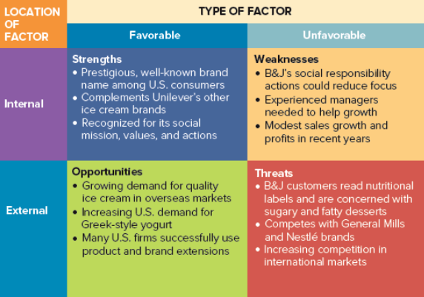
SWOT Analysis
- Loyal Customer Base
- Unique events
Combination of ultramarathons and military style obstacles
- Strong Community
- Design of race registration
- Customers leave MMC
- Past 10yrs 57.8% (Asia+)
- Entering new markets (diversify merch)
- Local and worldwide advertising
- Volunteer/charity programs
- Partnerships
- Improve website
- Technological challenges
- Public doesn’t like the idea
- Decrease of runners across the US and Europe
Notes:
Add introduction slide - CEO, Founder, about with the company
SWOT -increase font or make it darker (font increased + changed)
opportunities: market penetration in paper

Slide 4
The 4 P’s
Mendoza
Product (Good/Service)
Sell races/race tickets (An “Experience”/”Sense of belonging”)
Marathons/obstacle courses
Athletic, enjoyable, healthy, friendly competition
Promotion (Communication)
Advertisements (Creating social media + campaigns, billboards, TV commercials, local ads - radio stations)
^ Include a mission statement
Help options (Website chat bot, customer support line)
Partnerships/collabs/sponsorships
Price (Exchanged)
Offer affordable tickets/memberships
Place (Giving Product)
Ticket booths, online sales, + possible over-the-phone sales
Western States Endurance Run
Product
100 mile race
Promotion
Suponsors
Qualifying races
Price
$410 entry fee + online fees
Place
Held annual in California
Notes:
Western States Endurance Run
Write out the wSER
Start out with product

Slide 5
The Problems
There are two main problems:
Inefficient Registration Process
Unused Bibs at the Events
Notes:
Ties with weakness and threats
Maybe in paper add about unused bibs

Slide 6
Alternatives:
Option 1: Increase Exclusive membership $2,200
Two free events per year
Exclusive member-only events
Discounts on official merchandise
Priority registration at every event
Option 2: Increase Exclusive membership $2500-$2800
Have partnerships (Airlines, hotels, and sporting stores)
Expand MMC Store with partnerships
No entry fee for 5 races
Create charity and donate 15% of all money to it
Notes:
Option 2= Partnership= share same core values. Is beneficial to everyone and helps the company expand/grow.
MMC Store= Better products bc of sporting stores, have logos on merch with sponsors/partners.
Create charity: Will give runners a cause to run for, it will also demonstrate that all the money is not going to corporate.

Slide 7
In Conclusion…
Option #2:
Core customers
Charities
Donation (running for a cause)
Partnerships
Grow brand
5 “free” races
Questions?
Notes:
In conclusion, we recommend … #2 more than just price → charities, fits with core values, donation, partnership =grow brand maybe add more races (Asia)
Tie with market development

